Slide 1
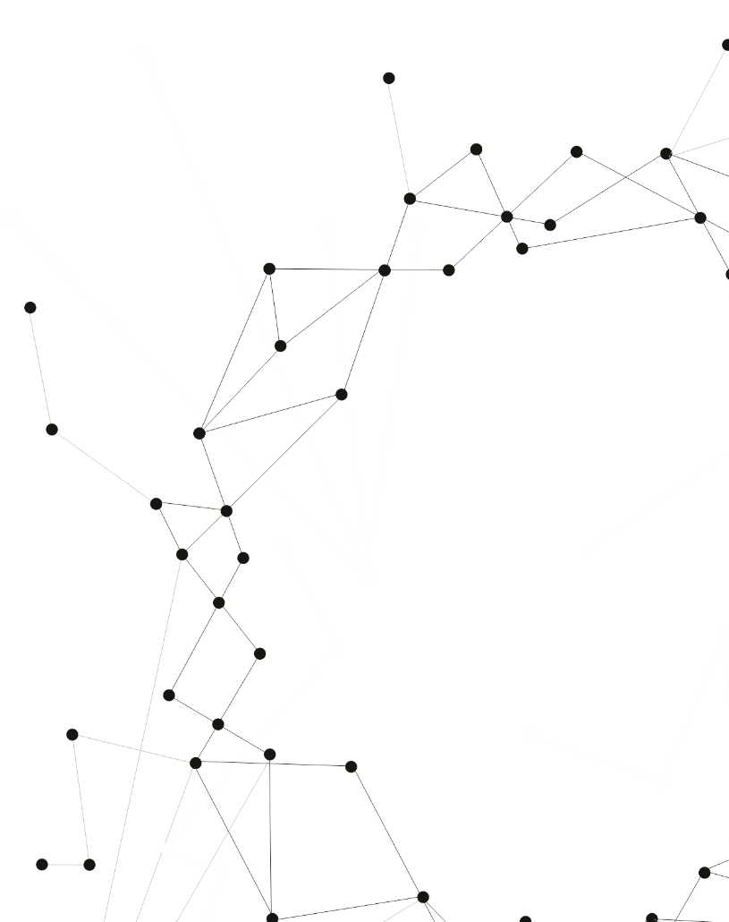
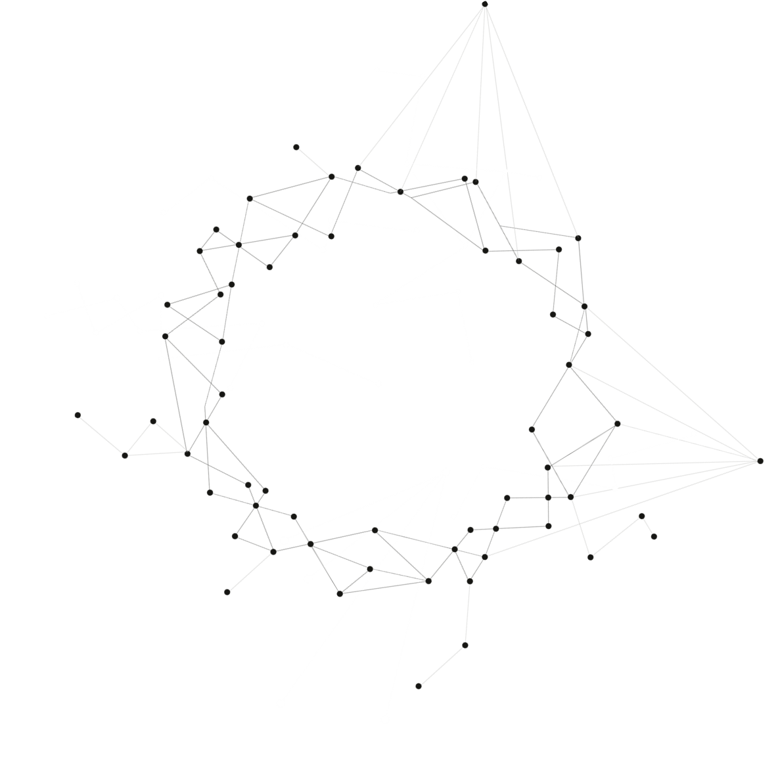
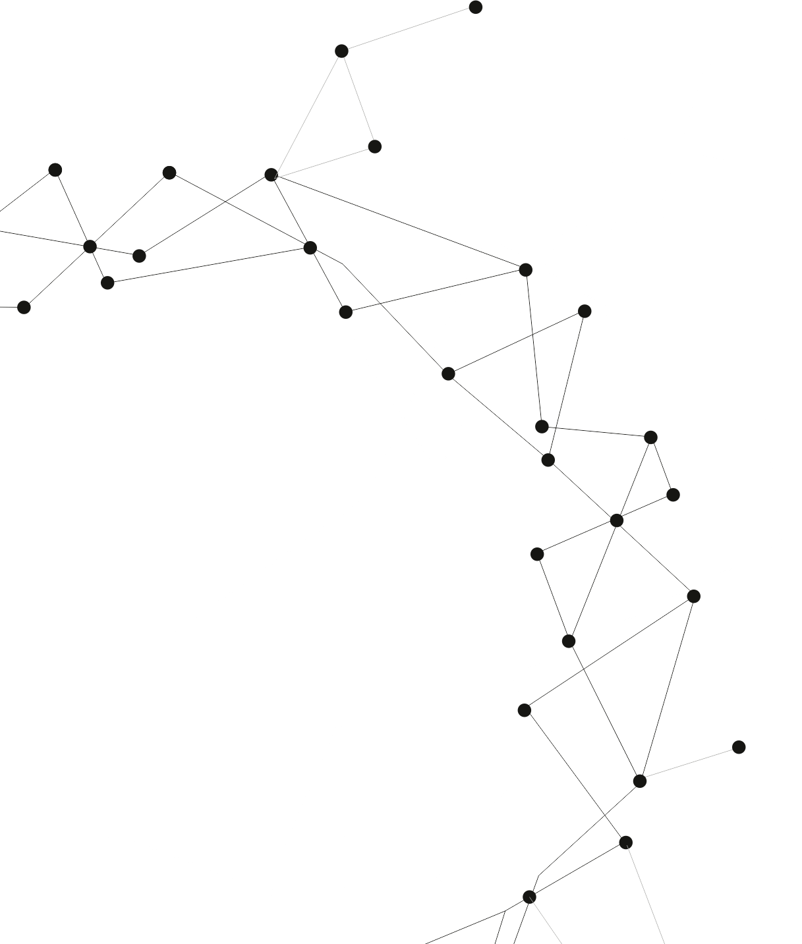
CPS530 - Group Project
A Traveler Helper Web
Ruoling Yu, Wentao Bai, Yang Xu
Group 18, Section 3 & 4

Slide 2
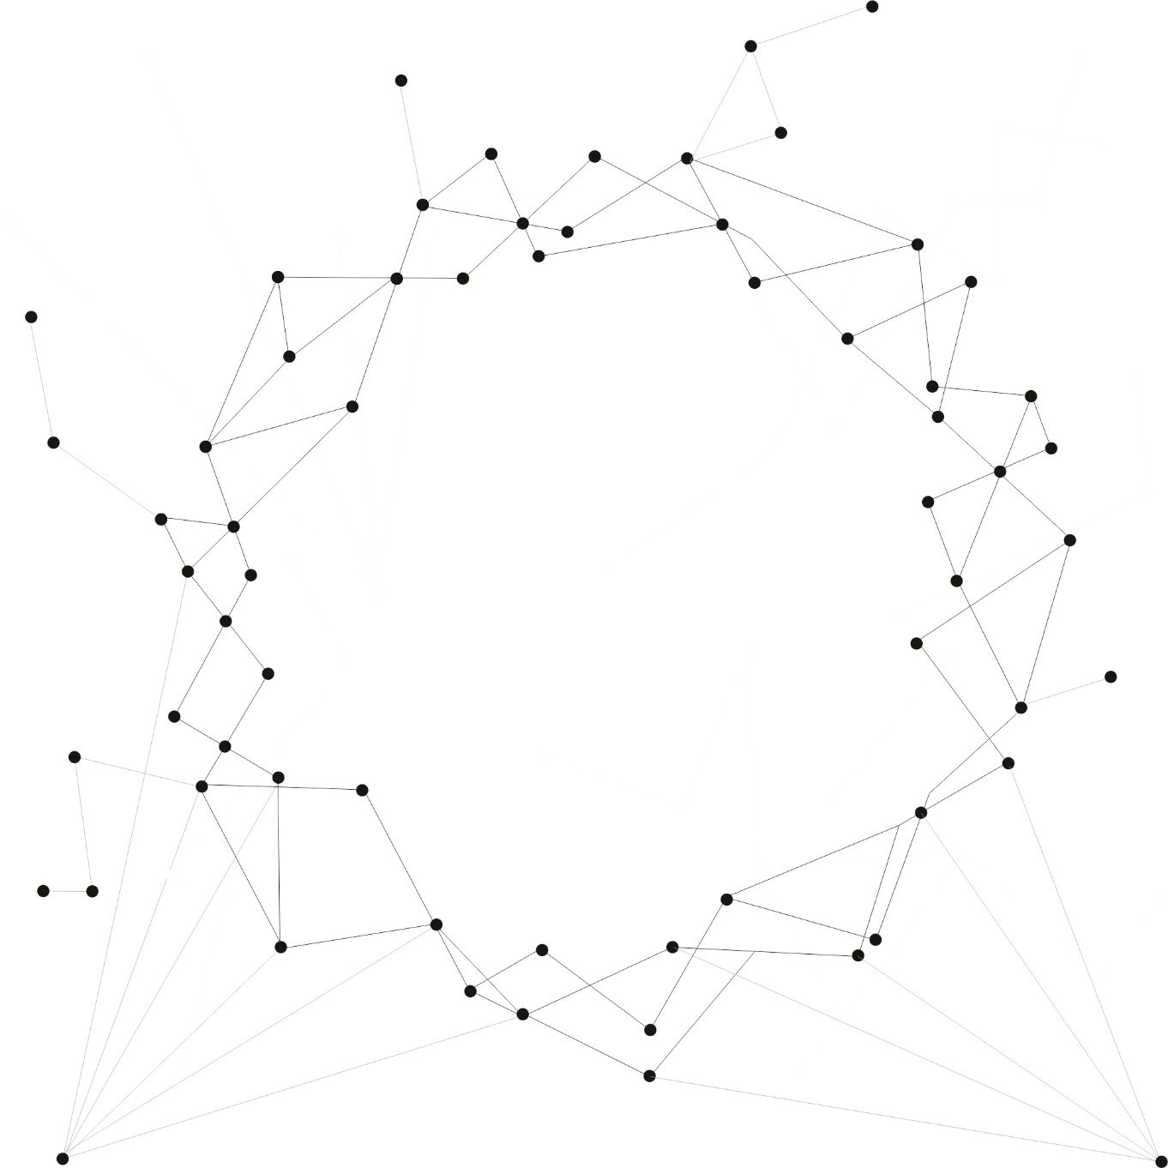
01
INTRODUCTION

Slide 3
A Traveler Help Page
Reason why to choose the topic
Covid19 => the desire to travel has grown stronger.
Target Audience
For those who want to travel after covid19 but don't know exactly where to go.
Why it’s useful
information on the seven continents
weather and climate
places of interest
recommendations from other traveler.
Notes:
Reason why to choose the topic
Due to covid19, many people have been forced to stay home, and over time the desire to travel has grown stronger.
Target Audience
For those who want to travel after covid19 but don't know exactly where to go.
Why it’s useful
This page contains information on the seven continents: weather and climate, places of interest and recommendations from other traveler.

Slide 4
02
Web Layout

Slide 5
Notes:
This is our tree map for our web page, and we start with an animation page, which will lead us to the home page.
On the home page, we got a login function and a comment page where you can see comments from other users and travelers.
By clicking the map on hone page, you will have access to all seven continents and for each continent, we have both a brief and a detailed page to help you get to know it better.

Slide 6
03
Techniques

Slide 7
HTML
PHP
CSS
JAVASCRIPT
jQuery
MYSQL
Notes:
For this website, we have most of the techniques taught in this course, which include:

Slide 8
04
Website Demo

Slide 9
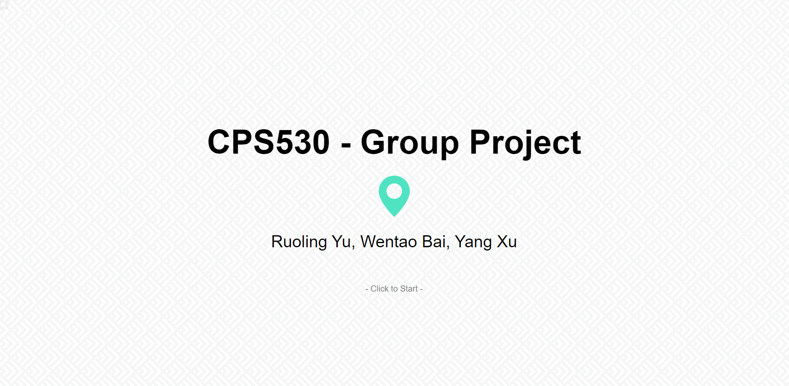
- Click to Start -
Notes:
Let’s see the demo for the website.

Slide 10
05
F A Q
Thank you for your time!

